Slide 1

Serverless The battle of the Giants @ChristosMatskas @loige
Fullstack 2017 - 14th July, London

Slide 2
If you are cool, you already have these:
1
Your own Azure account
2
A laptop with Node.js >= 6.10 installed and a CMD/Terminal
3
Azure Core Tools installed and authenticated
4
A REST client of your choice
5
A laptop turned on and connected to the Wi-fi
6
For Vouchers with free Azure credits – see @ChristosMatskas

Slide 3
Preparation
Setup you Azure Account

Slide 4
For this workshop you’ll need:
1
An Azure Resource Group
2
An Azure Function App
3
An Azure Storage Account

Slide 5
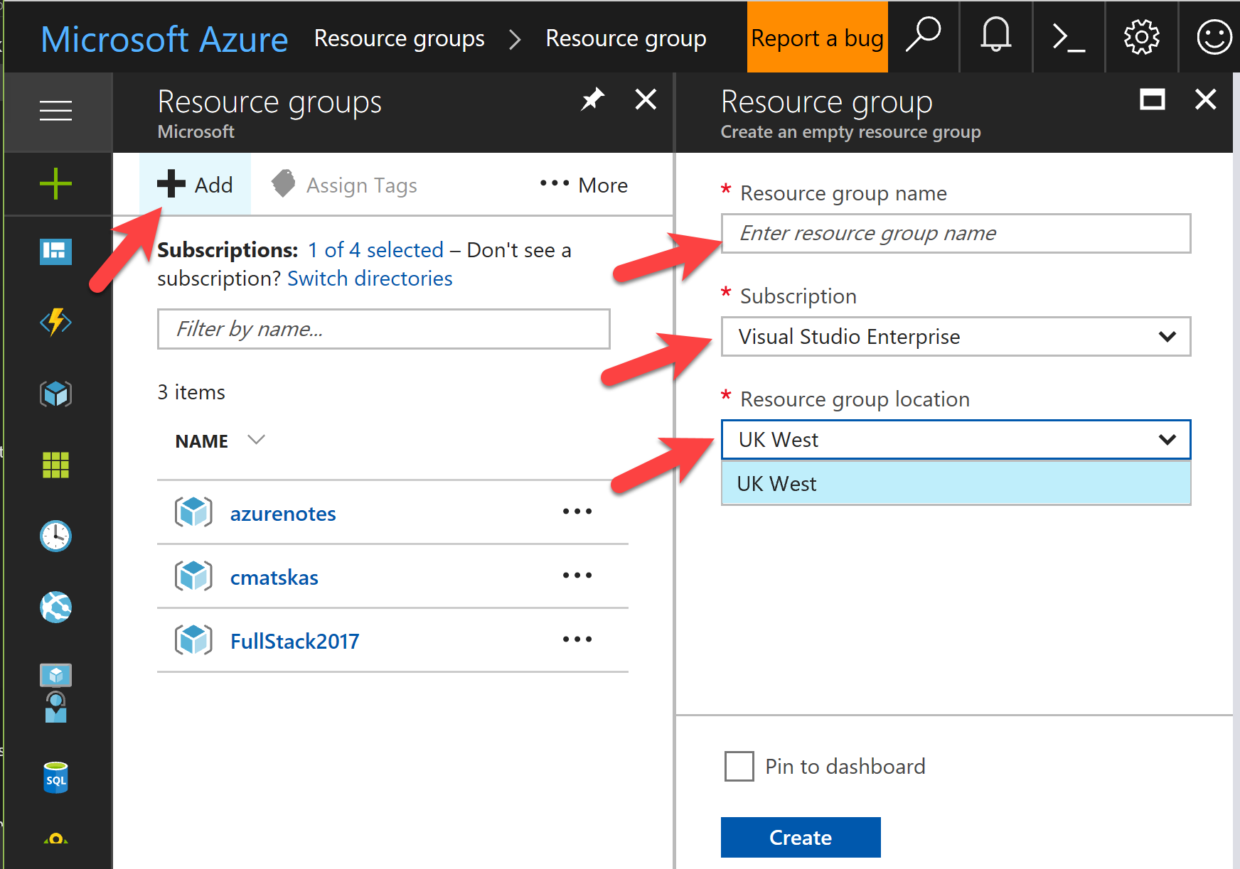

Slide 6
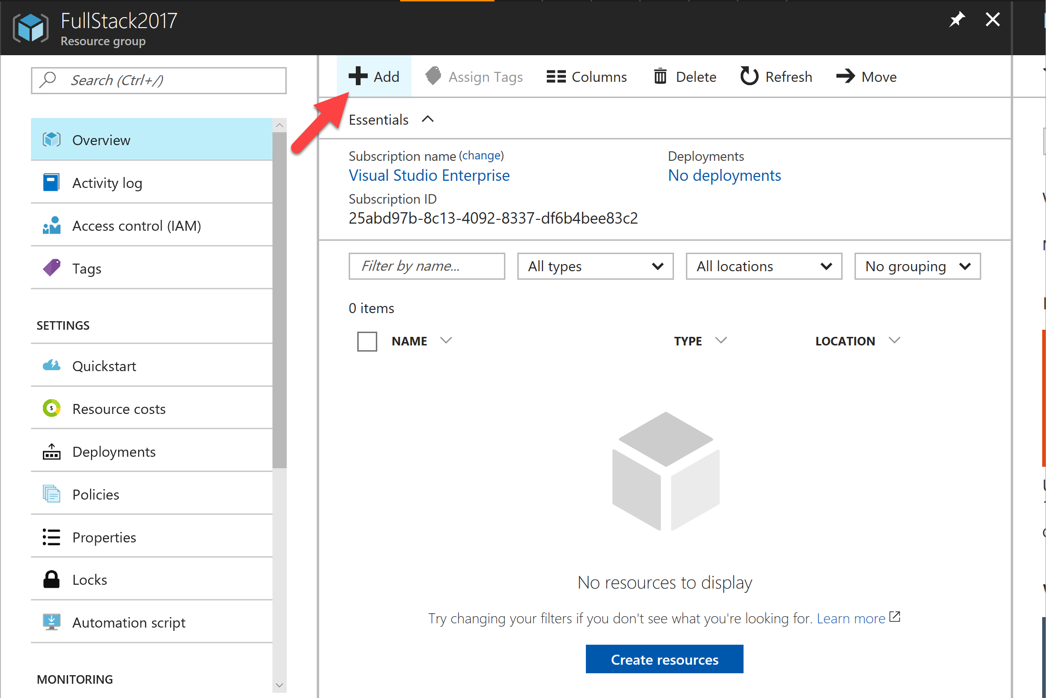

Slide 7
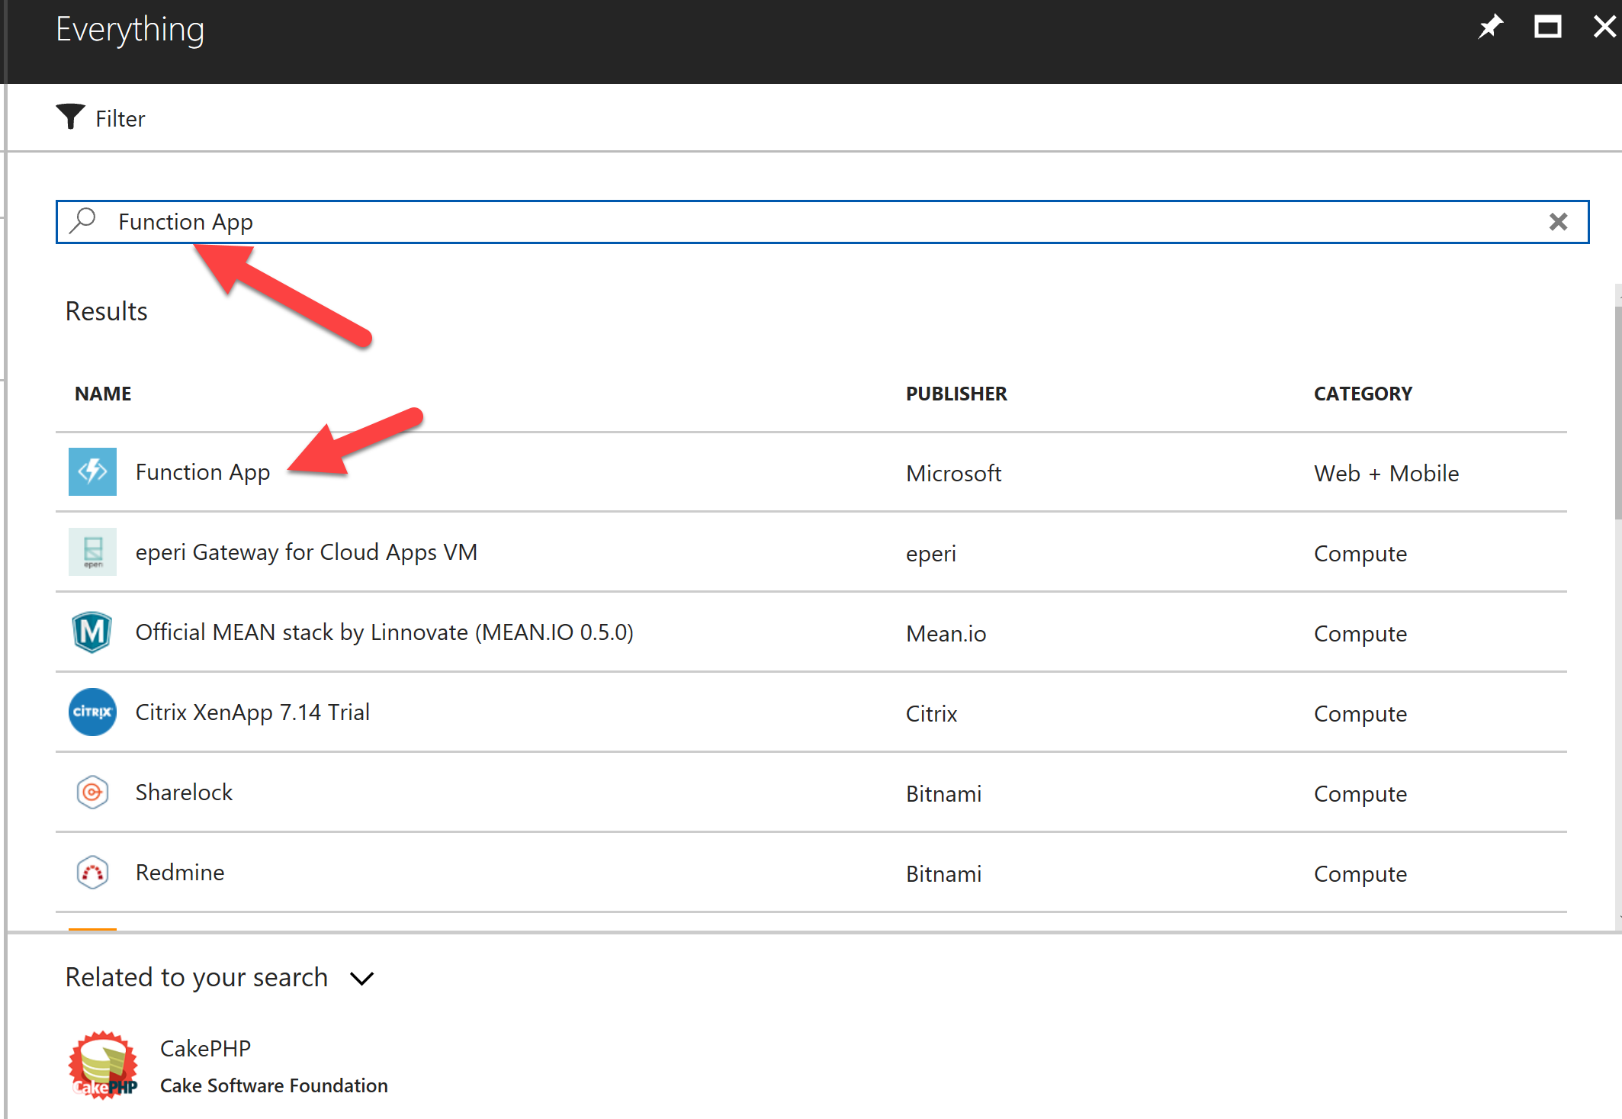

Slide 8
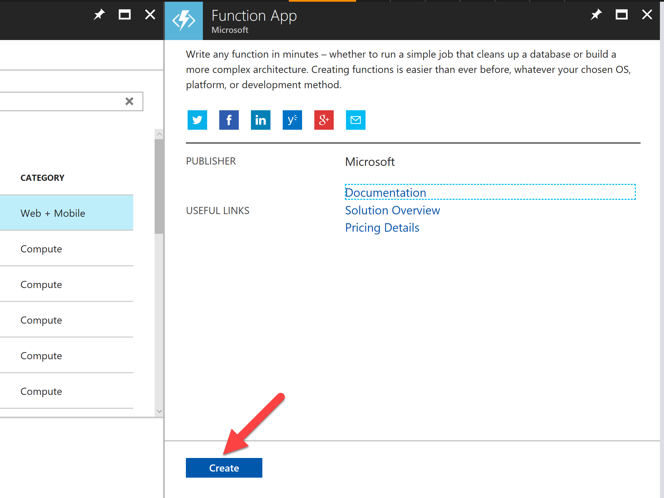

Slide 9
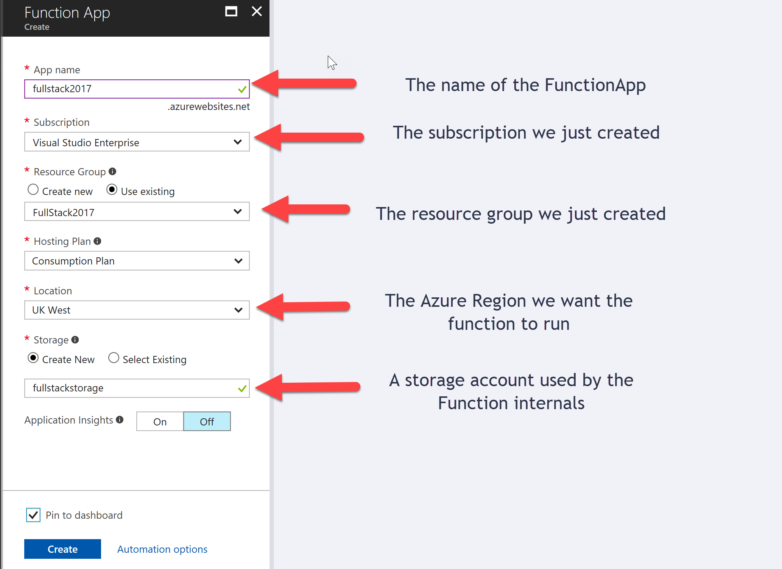

Slide 10
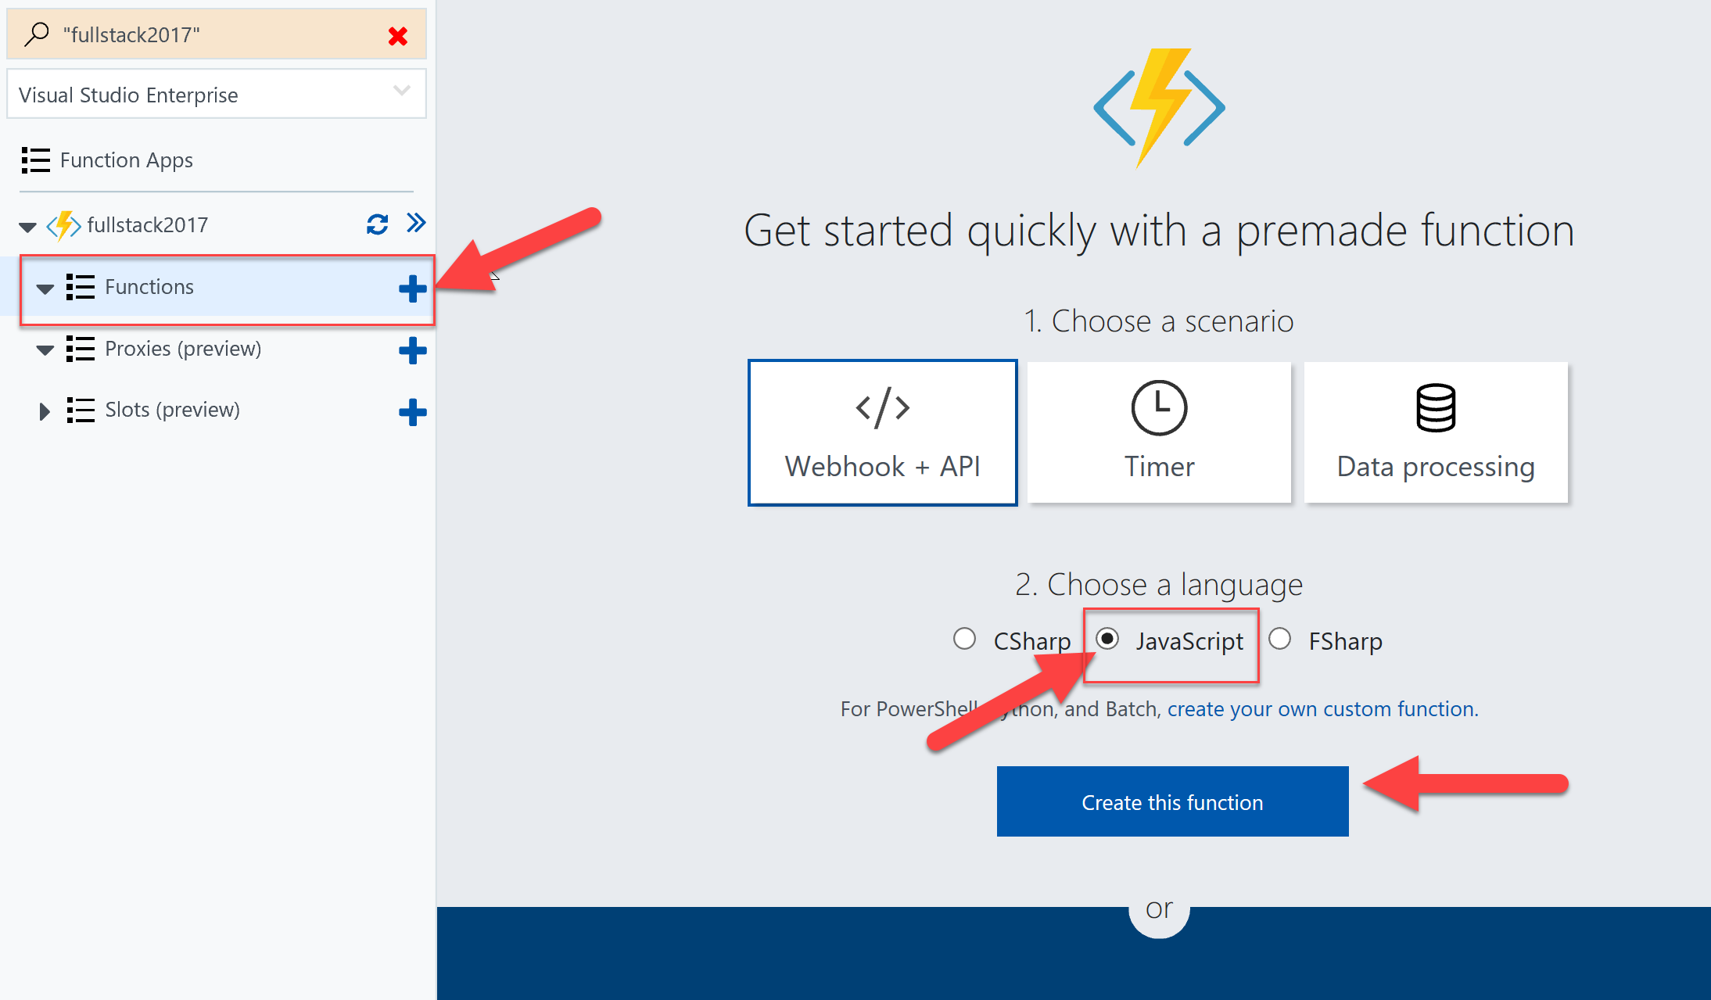

Slide 11
Getting to know the workspace

Slide 12
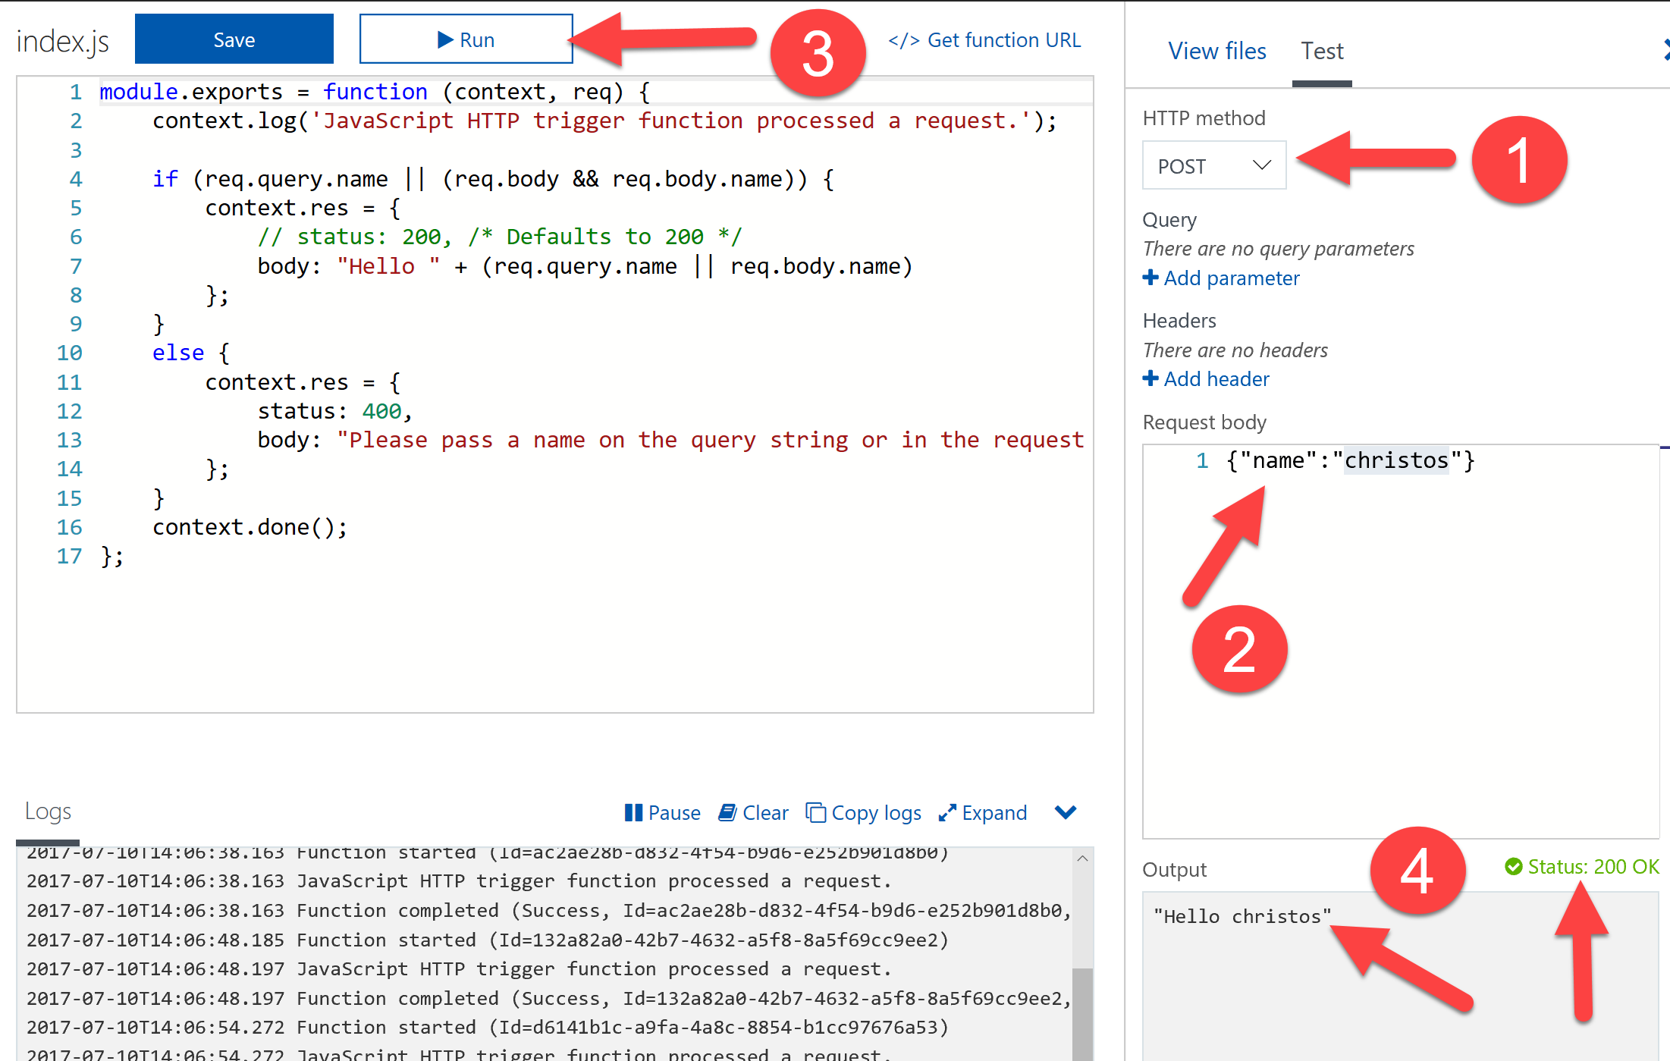
Testing Functions in the Azure Portal

Slide 13
Part 1: Hello World

Slide 14
Working with the CLI
mkdir FullStack2017 && cd FullStack2017
func azure login
func azure subscriptions list
func azure subscriptions set <Subscription Guid>

Slide 15
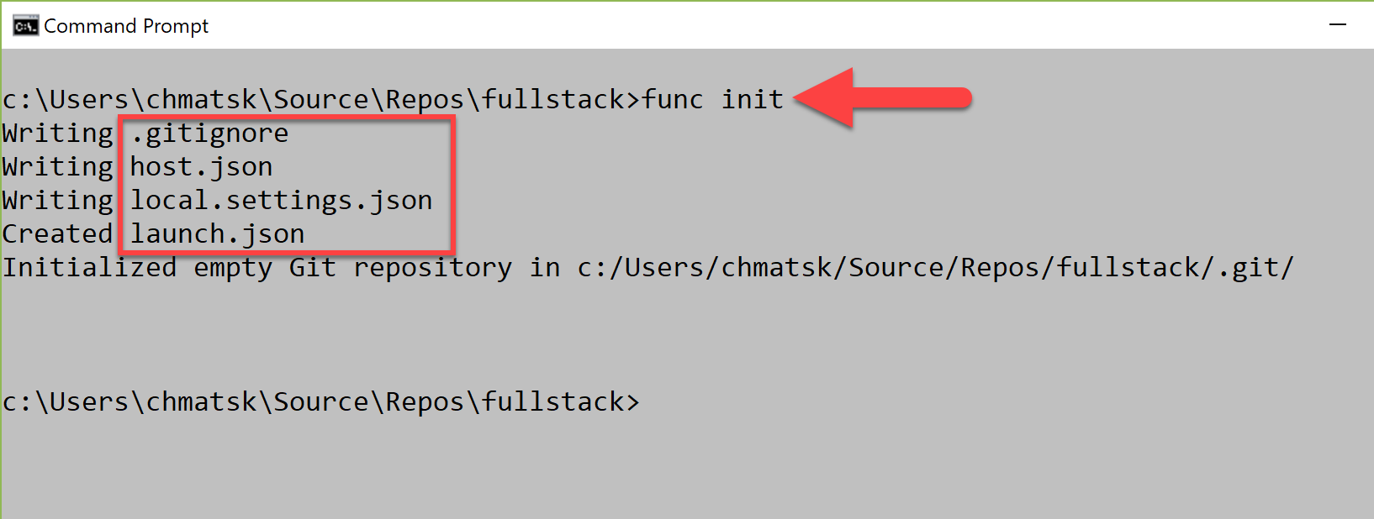
Initialise the Function

Slide 16
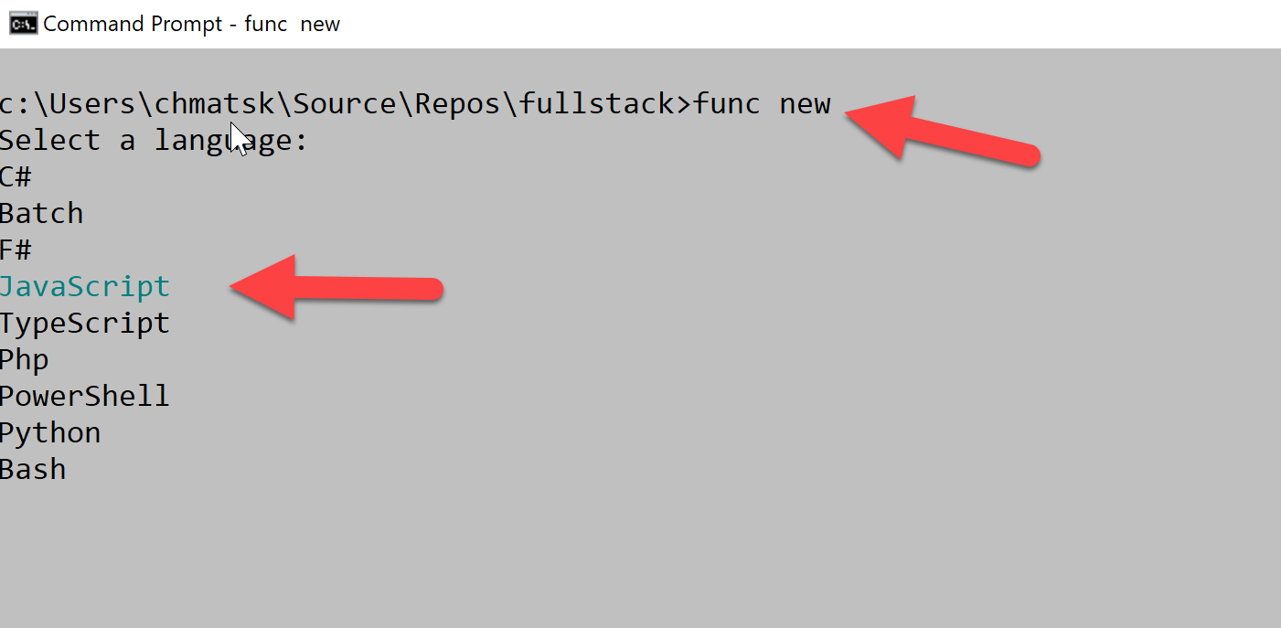
Create a new Function

Slide 17
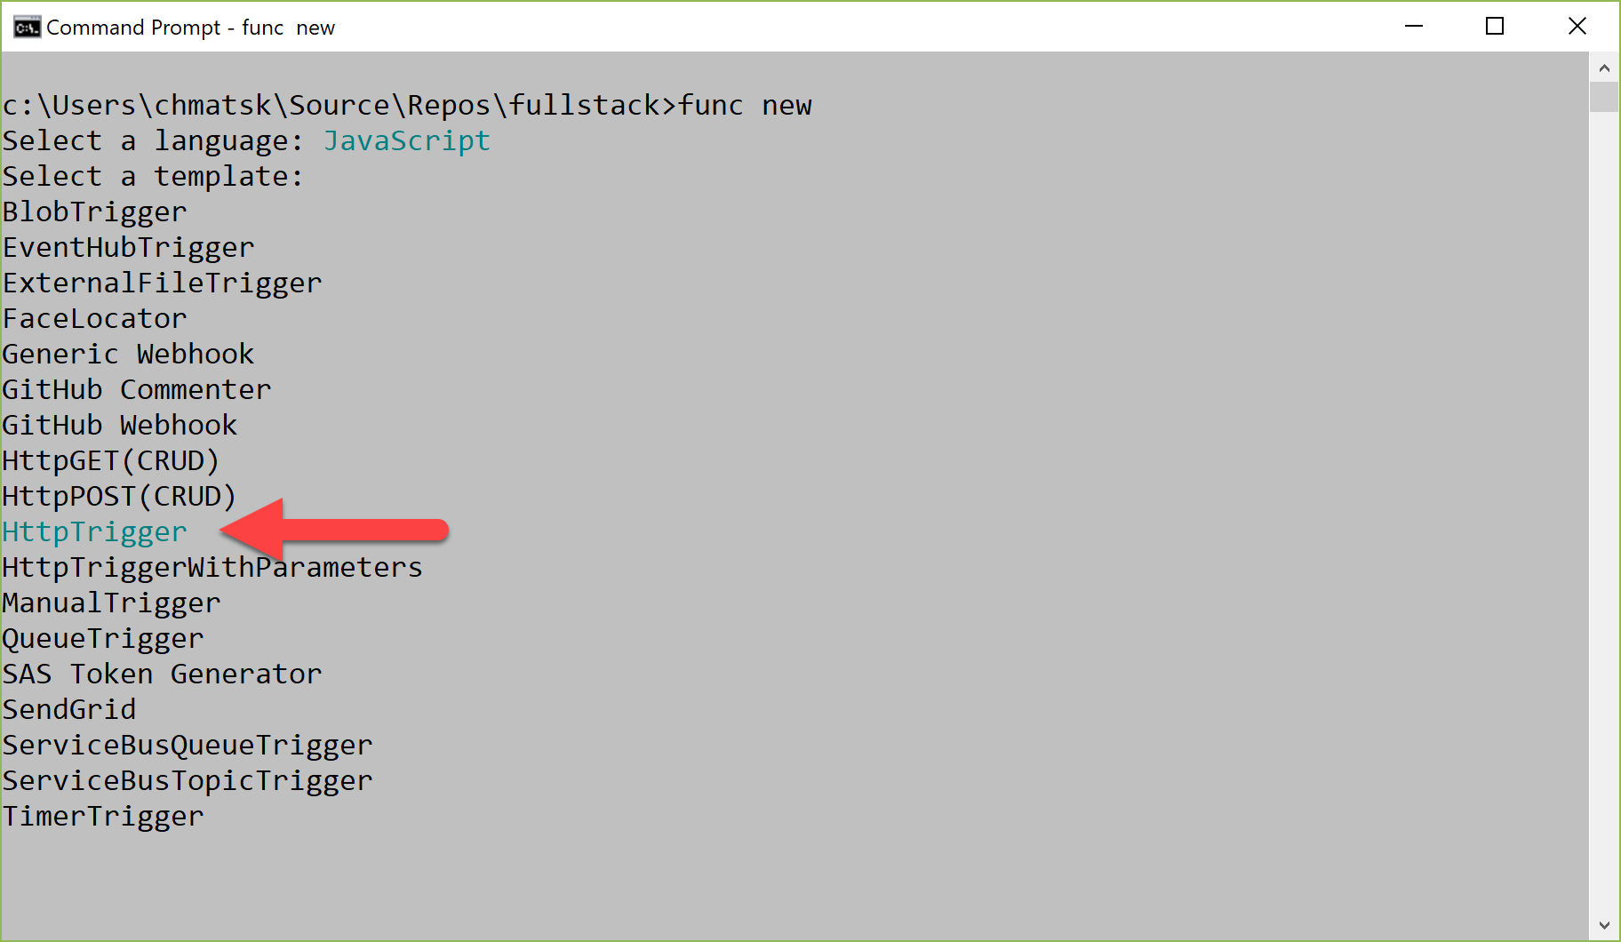
Choose the language

Slide 18
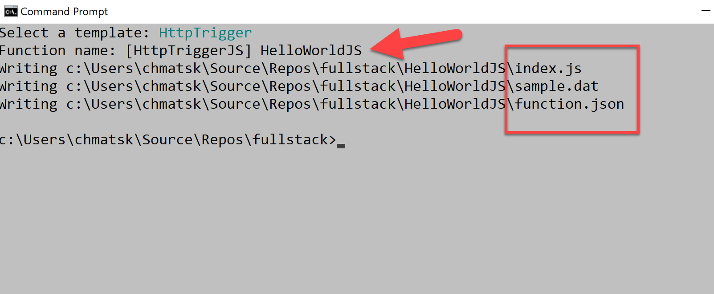
Name and create Function

Slide 19
Final Structure

Slide 20
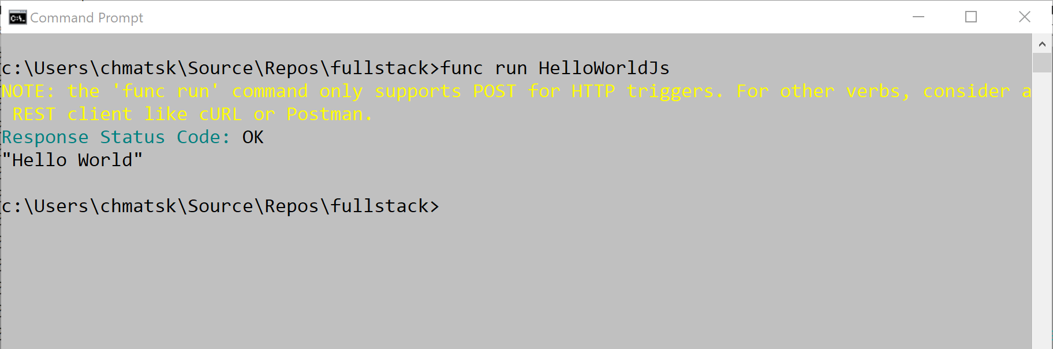
Running locally
func run HelloWorldJS

Slide 21
Part 1 Recap
Writing our first Azure Function (web console and local)
Using an HTTP trigger
Local testing
Testing using the portal

Slide 22
Part 2: Advanced Hello World

Slide 23
Advanced Hello World Function
Given an HTTP GET URL parameter or HTTP POST payload, e.g.
http://localhost:7071/api/AdvancedHelloWorldJS?name=Christos
You should receive an HTTP 200 Response with the following JSON result e.g.
200 OK
“Hello Christos”

Slide 24
Create the Function from the CLI
func new
JavaScript ->
HttpTrigger ->
AdvancedHelloWorld ->
Use default code

Slide 25
Running locally
func run HelloWorldJS -c "{\"name\": \"Christos\"}"

Slide 26
Part 2 Recap
Reading input from the event object
Using query string parameters in REST APIs

Slide 27
Part 3: FizzBuzz

Slide 28
Reading HTTP request body
You can read the body of a request with: req.body
module.exports = function (context, req) { if (req.body && req.body.someparameter){
console.log(req.body.someparameter);
}
}

Slide 29
Return HTTP error responses
You can create any HTTP response object with the following syntax:
context.res = {
status: 400,
body: “Any error message you need to return to the user"
};
context.done();

Slide 30
Return HTTP error responses
For example if you want to return a 404 in an API:
module.exports = function (context, req) { context.res = {
status: 404,
body: “File Not Found"
};
context.done();
}

Slide 31
Fizz Buzz
1, 2, Fizz, 4, Buzz, Fizz, 7, 8, Fizz, Buzz, 11, Fizz, 13, 14, Fizz Buzz, 16, 17, …
Rules:
Given n (positive integer) as input:
If n is divisible by 3 and 5 => Fizz Buzz
If n is divisible by 3 => Fizz
If n is divisible by 5 => Buzz
Otherwise => n

Slide 32
Fizz Buzz
Exercise: Implement a Fizz Buzz REST API, where:
The input (n) comes from the request body (request must be POST)
The output is:
{“result”: “(Fizz|Buzz|Fizz Buzz|\d+)”}
If the input is not valid, return a 400 Bad Request response with body:
{“error”: “Invalid body, a positive integer was expected”}

Slide 33
Part 3 Recap
Read the body of a POST request
Returning custom HTTP status codes

Slide 34
Part 4: Timezone Conversion

Slide 35
Reading path parameters
You can read a path parameters: req.query module.exports = function (context, req) { if (req.query && req.query.someparameter){
console.log(req.query.someparameter);
}
}

Slide 36
Using external libraries in your Azure Functions
You can install and use any external library from NPM in your src folder.
cd <YourFunctionDirectory>
npm init -y
npm install --save lodash

Slide 37
Using external libraries in your Azure Functions
Then you can simply require the library in your function:
// index.js
const _ = require(‘lodash’);
module.exports = function (context, req) {
context.res = {
body: _.now()
};
context.done();
})

Slide 38
Timezone conversion API
Exercise: Implement a timezone conversion REST API, where you receive 3 inputs as path parameters:
timestamp is a timestamp in ISO 8601 format (e.g. 2018-05-17T22:13:10)
sourceTimezone the source timezone (e.g. Europe/London)
targetTimezone the target timezone (e.g. Australia/Sydney)
The API response is a JSON object containing the converted timestamp. E.g.:
{"timestamp":"2018-05-18T07:13:10+10:00"}

Slide 39
HINT: Converting timestamps across timezones
Use the moment-timezone library:
const resultTimestamp = moment.tz(
timestamp,
sourceTimezone).tz(targetTimezone).format();
npm install –save moment-timezone

Slide 40
Part 4 Recap
Working with multiple path parameters in REST APIs
Using external libraries from NPM

Slide 41
Part 5: Weather Scrape on Schedule

Slide 42
Working with timers
The functions.json file is used to define input and output bindings.
Timers bindings use CRON time formats to schedule Functions
"bindings": [
{
"name": "myTimer",
"type": "timerTrigger",
"direction": "in",
"schedule": "0 */1 * * * *"
}

Slide 43
Using environment variables
Functions rely on Environmental Variables for retrieving sensitive information.
Locally, this is supported through the local.settings.json file
"StorageConnectionString": “some-connection-string",
"LOCATION": "London ,uk",
"API_KEY": “<some-api-key“
In the code:
const api-key = process.env[‘API_KEY’];

Slide 44
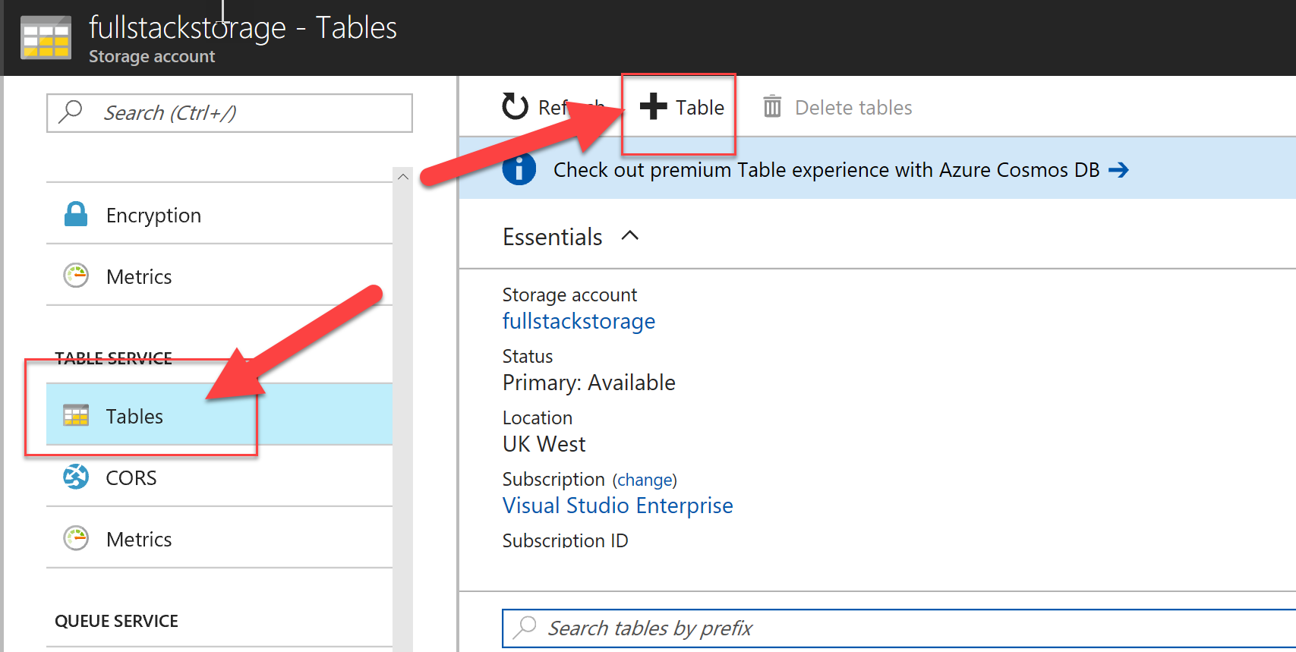
Working with the Azure Storage Account

Slide 45
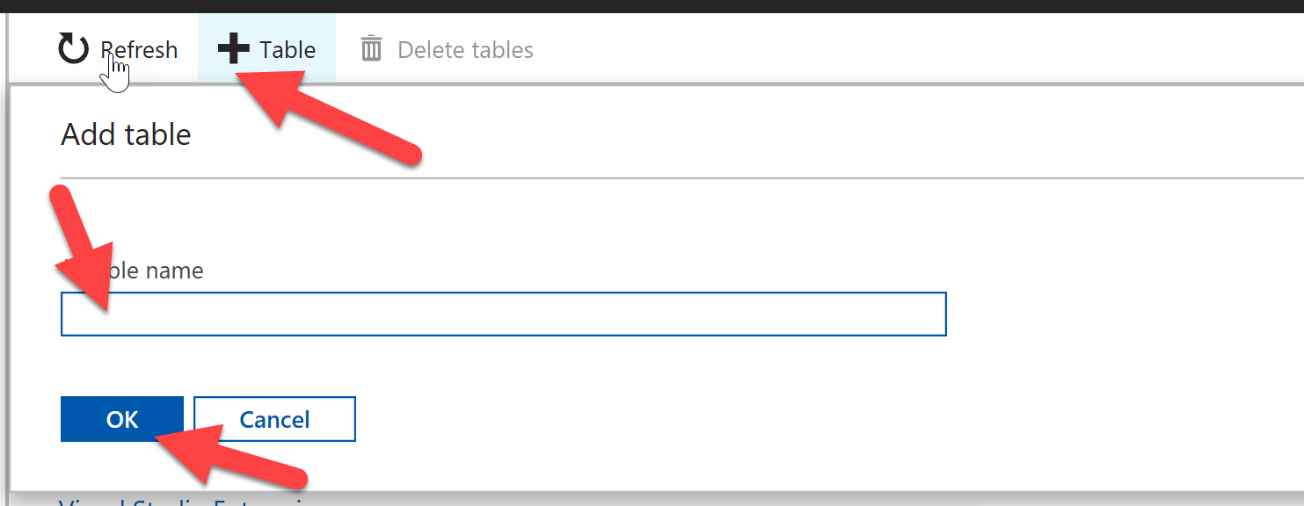
Create the table to store our data

Slide 46
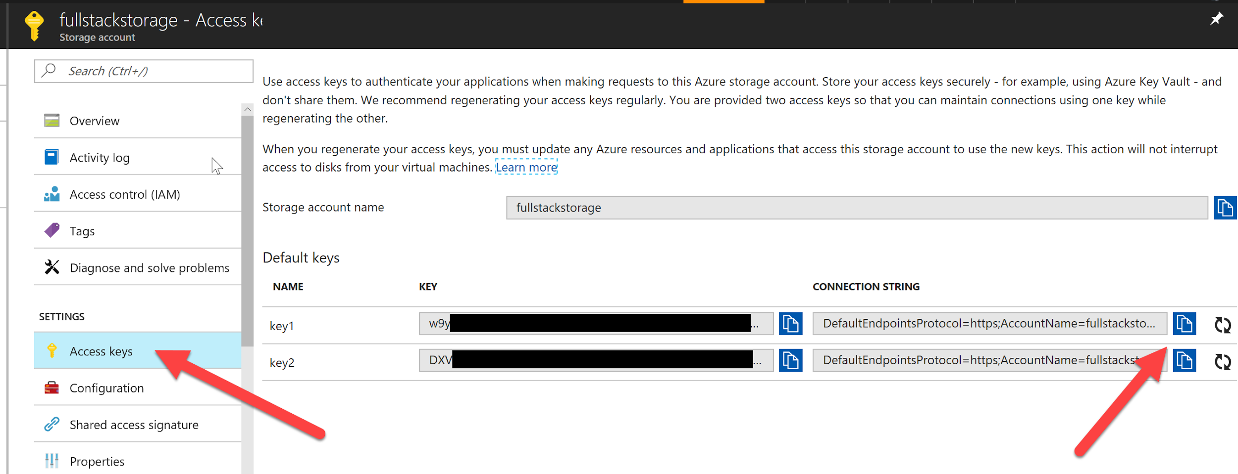
Get the Storage Connection String

Slide 47
Weather forecast scraper
Exercise:
Implement a function that retrieves weather forecast for a specific area every 2 hours and stores the results in an Azure Storage Table.

Slide 48
HINT #1: Use Open Weather Map APIs as data source
With this API you can simply issue an HTTP request:
const url = `http://api.openweathermap.org/data/2.5/forecast`
const qs = { q: LOCATION, appid: API_KEY }
request({url, qs}, (err, {body}) => {
const data = JSON.parse(body)
// …
}
You will need to register for an API Key

Slide 49
Working with 3rd party services - Weather data
In your Function, you can use code to call into 3rd party services
cd <YourFunctionName>
npm install --save request

Slide 50
HINT #2: Working with Azure Storage
Option 1: Use a Storage Table binding (built-in but limited)
Option 2: Use the Node.js Azure Storage SDK
cd <yourFunctionName>
npm init --y
npm install --save azure-storage

Slide 51
HINT #2: Working with Azure Storage - node.js
Create an instance of the Azure Storage Client
let azure = require('azure-storage’);
let tableSvc = azure.createTableService(process.env['StorageConnectionString']);
tableSvc.createTableIfNotExists('mytable', function(error){
if(error){
console.error(error);
}
});

Slide 52
HINT #2: Working with Azure Storage - node.js
Use the Azure Storage Client to insert or update data in the storage table
tableSvc.insertOrReplaceEntity('weatherdata',item, function(error, result) {
if(error){
console.error(error);
}
});

Slide 53
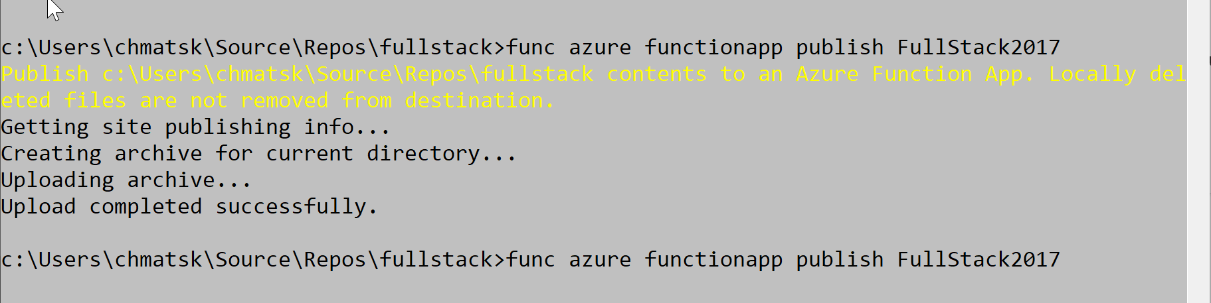
Deploy / Publish to Azure
func azure functionapp publish FullStack2017

Slide 54
Using Environment Variables – Publish
When publishing the Function to Azure, you get the choice to also publish and optionally overwrite the remote settings with the local ones.
func azure functionapp publish <YourFunctionName> --publish-local-settings -i --overwrite-settings -y

